Slide 1
Coordination compounds
III year B.Sc.
Paper-v
Module-1
P.R.Government College (A) Kakinada
G. Ramalakshmi

Slide 2
22.1 Coordination Compounds
Coordination compounds contain
coordinate covalent
bonds formed
between metal ions with groups oafnions oprolar molecules.
Metal ion – Lewis acid
Bonded groups – Lewis base
Complex ion – ion in which a metal cation is covalently bound to one or more molecules or ions

Slide 3


Components of a coordination compound
  Complex ion (enclosed in square barckets)
  Counter ions
  Some coordination compounds do not contain a complex ion
  Most of the metals in complexes are transition metals

Slide 4
Properties of transition metals
–Have incompletely ﬁlledd subshells
–Or react to form ions with incompletely
ﬁlledd
subshells
Distinctive colors
Paramagnetism
Catalytic activity
Tendency to form complex ions
–Exhibit variable oxidation state

Slide 5
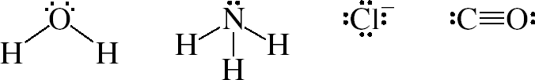

Ligands - the molecules or ions that surround the metal in a complex ion
– Must contain at least one unshared pair of valence electrons
–Donor atom – atom in the ligand directly bonded to the metal atom

Slide 6
– Coordination number – number of donor atoms surrounding the central atom
Common coordination numbers: 4 and 6
Classiﬁcations of ligands
  Monodentate – 1 donor atom
  Bidentate – 2 donor atoms
  Polydentate - > 2 donor atoms
  Chelating agents – another name for bidentate or polydentate ligands
Overall charge on the complex ion is determined by
  Oxidation state of the metal
  Charges on the ligands

Slide 7
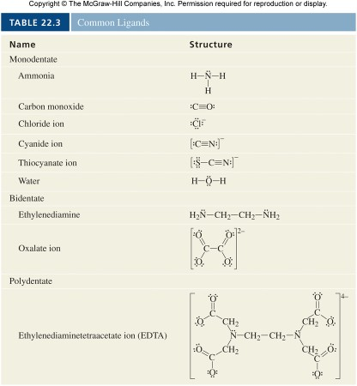
(en)

Slide 8
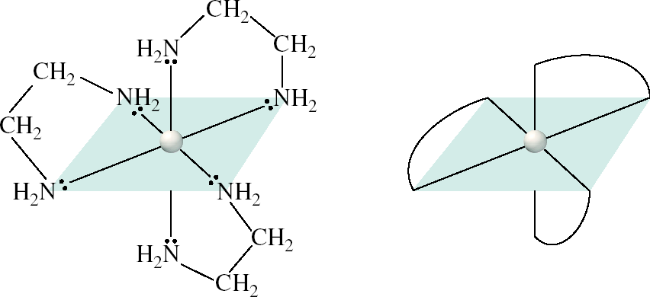
Representations of [Co(en)₃]²⁺

Slide 9
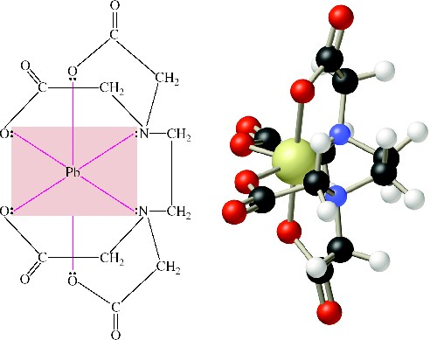
Representations of [Pb(EDTA)]²⁻

Slide 10
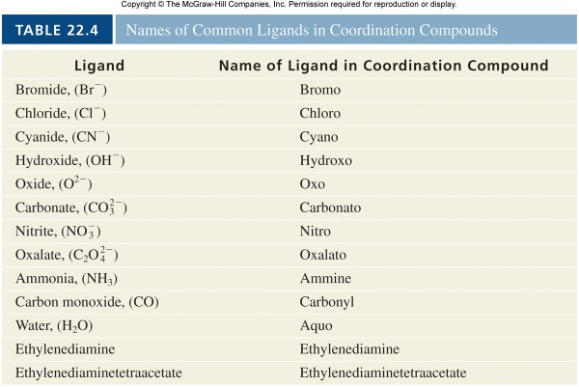
(en)
(EDTA)

Slide 11
Determine oxidation number for the transition metal, Au, in
K[Au(OH)₄]

Slide 12
K[Au(OH)₄] consists of a complex ion (the
part of the formula enclosed in square brackets) and one K counter ion. Because the overall charge on the compound is zero,
the complex ion is [Au(OH)₄]⁻. There are four
ligands each with a −1 charge, making the total negative charge − 4. So the charge on the gold ion must be +3.

Slide 13
Nomenclature of Coordination Compounds
  The cation is named before the anion, as in other ionic compounds.
  Within a complex ion, the ligands are named ﬁrst, in alphabetical order, and the metal ion is named last.
  The names of anionic ligands end with the lettero, whereas neutral ligands are usually called by the names of the molecules. The exceptions are H₂O (aquo), CO (carbonyl), and
NH₃ (ammine).

Slide 14
– When two or more of the same ligand are present, use Greek preﬁxesdi -t, ri -t, etra -, penta -, andhexa - to specify their number.
(Preﬁxes are not included in determining the alphabetical order.) When the name of the ligand contains a Greek preﬁx, a different set of preﬁxes are used for the ligand: b2is= -, 3
tris= -t, e4tr=akis -
The oxidation number of the metal is indicated in Roman numerals immediately following the name of the metal.
If the complex is an anion, its name ends in -
ate. (Roman numeral indicating the oxidation state of the metaflollows the suﬃxa-te. )

Slide 15
Give the correct name for [Cr(H₂O)₄Cl₂]Cl.

Slide 16
[Cr(H₂O)₄Cl₂]Cl
Tetraaquodichlorochromium(III) chloride

Slide 17
Write the formula for
tris (ethylenediamine)cobalt(III) sulfate

Slide 18
tris (ethylenediamine)cobalt(III) sulfate
[Co(en)₃]₂(SO₄)₃

Slide 19
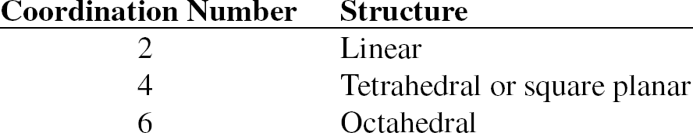
22.2 Structure of Coordination Compounds
Molecular geometry – plays a signiﬁcant role in determining properties
– Structure is related to coordination number

Slide 20
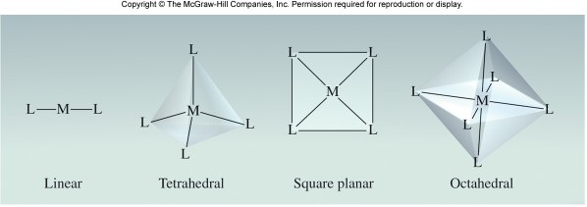
Common Geometries of Complex Ions

Slide 21
Stereoisomers
  Ligands arranged differently
  Distinctly different properties
Type of complex ion stereoisomerism
  Geometric isomers – cannot be interconverted without breaking chemical bonds
    Designated ascis andtrans

Slide 22
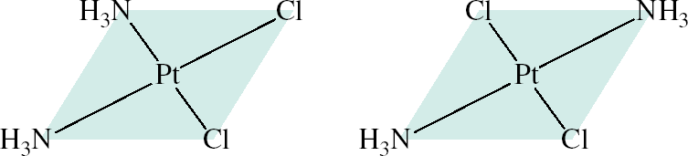
Cis andTrans Isomers of Diamminedichloroplatinum(II)

Slide 23
– Optical isomers – nonsuperimposable mirror images
Termedchiral
Rotate polarized light in different directions
–Rotation to the right – dextrorotatory (d isomer)
–Rotation to the left – levorotatory (l isomer)
Enantiomers – a pair ofd andl isomers
Racemic mixture – equimolar mixture of two enantiomers
–Net rotation of polarized light is zero

Slide 24
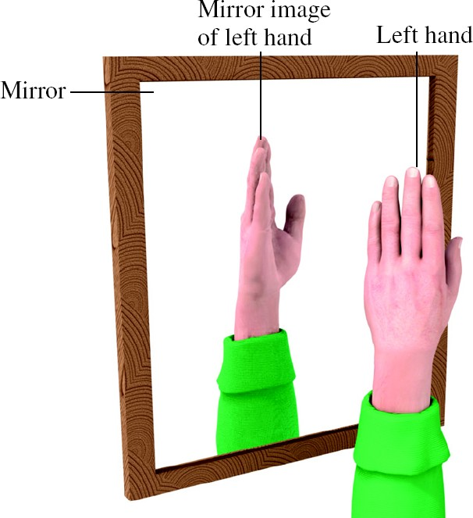
Nonsuperimposable Mirror Images: A Common Example

Slide 25
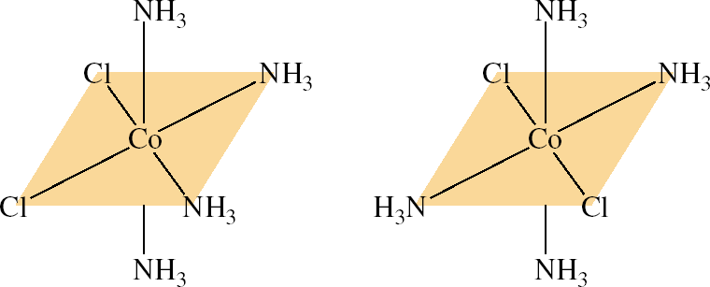


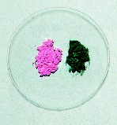
Nonsuperimposable Mirror Images: A Chemical Example

Slide 26
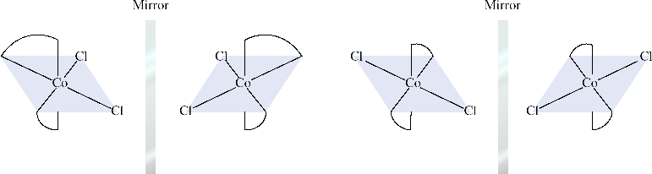
Optical Isomers of Geometric Isomers
cis
rotate in any manner nonsuperimposable
chiral
trans
rotate 90º superimposable achiral

Slide 27
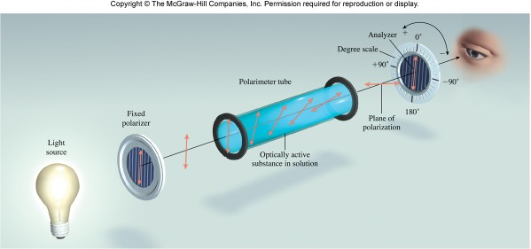
Operation of a Polarimeter

Slide 28
22.3 Bonding in Coordination Compounds: Crystal Field Theory
Crystal ﬁeld theory explains the bonding in complex ions purely in terms of electrostatic forces.
  Attraction between the metal ion (atom) and the ligands
  Repulsion between the lone pairs on the ligands and the electrons in thed orbitals of the metal
  In the absence of ligands, thed orbitals are degenerate

Slide 29
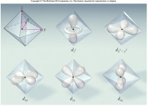
– In the presence of ligands, electrons ind orbitals experience different levels of repulsion for the ligand lone pairs
– As a result (depending on the geometry) some
d orbitals attain higher energy and others lower energy

Slide 30
– In an octahedral complex
the electrons in thed orbitals located along the coordinate axes experience stronger repulsions and increase in energy
the electrons in thed orbitals 45º from the coordinate axes experience weaker repulsions and decrease in energy
The energy difference between the two sets of orbitals is thecrystal ﬁeld splitting (Δ)
–Depends on the nature of metal and ligands
–Determines color and magnetic properties

Slide 31
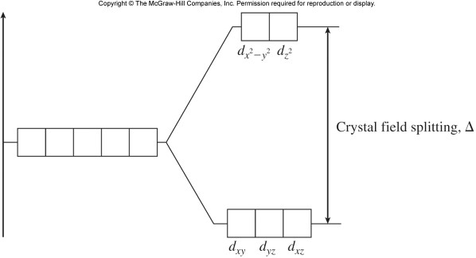
Crystal Field Splitting in an Octahedral Complex

Slide 32
Color
  As with reﬂected light,transmitted light (i.e., the light that passesthrough the medium, such as a solution) of selected wavelengths is responsible for color.
    The color of observed light is the complementary color the light absorbed.
    For example, a solution of CuSO₄ absorbs
light in the orange region of the spectrum and therefore appears blue.

Slide 33
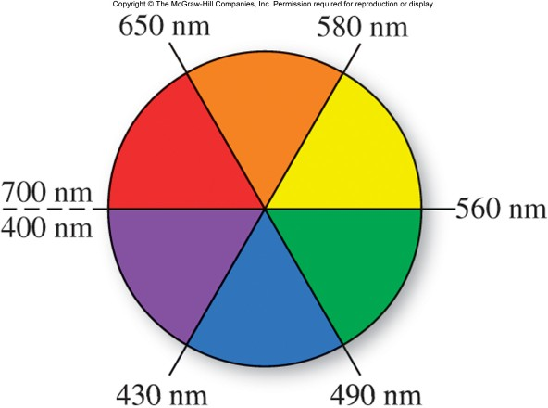
Color Wheel: Diagonal Complementary Colors

Slide 34
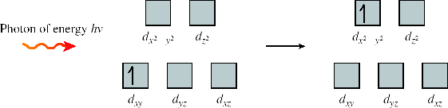
Δ = hυ= ^{hc}
– Relation to Δ
E = hυ= ^{hc}
λ
λ
– The amount of energy, Δ, to promote an electron from lower energyd orbitals to higher
energdy
orbitals

Slide 35
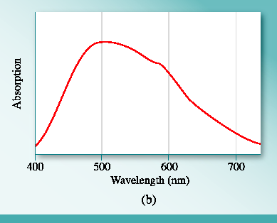
– Spectroscopic measurements of Δ allow an ordering of ligands ability to split thed orbitals
called sapectrochemical series .

Slide 36
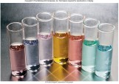
Spectrochemical Series
increasing
weak ﬁeld ligand
strong ﬁeld ligand
small Δ
large Δ

Slide 37
Magnetic Properties
  The magnitude of the crystal ﬁeld splitting also determines the magnetic properties of a complex ion
  The electron conﬁguration of the ion is a balance between
    Energy to promote an electron to a higher energyd orbital – related to the magnitude of Δ
    Stability gained by maximum number of unpaired spins

Slide 38
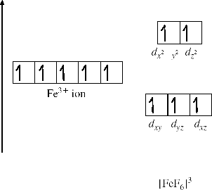
Small values of Δ favor maximum number of unpaired spin
  High spin complexes
  F⁻ is low on spectrochemical series

Slide 39
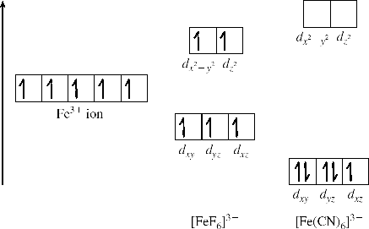
Large values of Δ are unfavorable for promotion
  Low spin complexes
  CN⁻ is high on the spectrochemical series

Slide 40
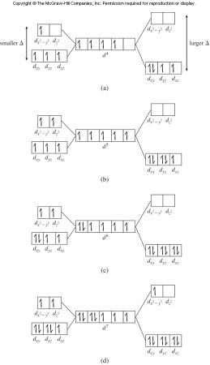
Orbital Diagrams for Speciﬁcd Orbital Conﬁgurations

Slide 41
Tetrahedral and square planar complexes
  Proximity of the ligands tod orbitals changes with the geometry of the complex
–d electrons in orbitals more closely associated with the lone pairs of ligand electrons attain higher energies
  Splitting patterns reﬂect this repulsion

Slide 42
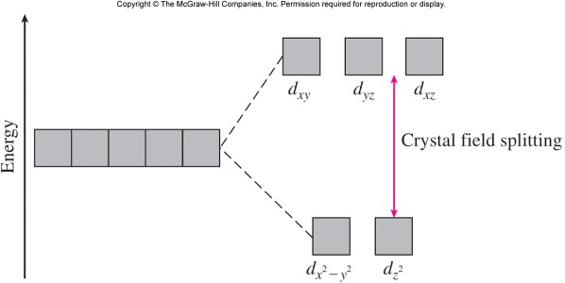
Crystal Field Splitting with a Tetrahedral Geometry

Slide 43
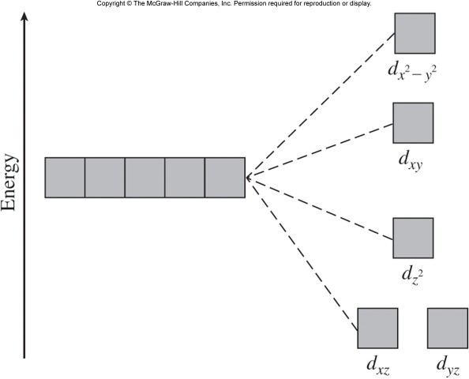
Crystal Field Splitting with a Square Planar Geometry

Slide 44
How many unpaired electrons are in [Mn(H₂O)₆]²⁺?
Hint: H₂O is a weak ﬁeld ligand.

Slide 45
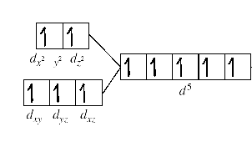
Mn²⁺ has an electron conﬁguration of
d ⁵. Because H₂O is aweak -ﬁeld ligand, we expect [Mn(H₂O)₆]²⁺ to be a high-spin
complex. All ﬁve electrons will be placed in In separate orbitals before any pairing occurs.There will be a total of ﬁve unpaired spins.

Slide 46
22.4 Reactions of Coordination Compounds
Complex ions undergoligand exchange
(orsubstitution ) reactions in solution.
– Example: Exchange of NH₃ with H₂O
– Rates of exchange reactions vary widely

Slide 47
– Exchange reactions are characterized by
Thermodynamic stability – measured byK _{f}
–LargeK _{f} values indicate stability
–SmallK _{f} values indicate instability
Kinetic lability – tendency to react
–Labile complexes undergo rapid exchange
–Inert complexes undergo slow exchange
Thermodynmically stable complexes can be labile or inert

Slide 48
22.5 Applications of Coordination Compounds
Metallurgy – extraction by complex formation
Chelation therapy – removal of toxins by chelation
Chemotherapy – use of complexes to inhibit the growth of cancer cells

Slide 49
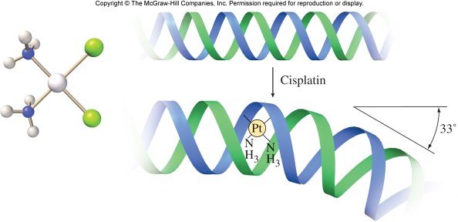
Mechanism of Cisplatin in Chemotherapy

Slide 50
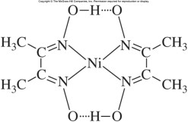
Chemical analysis – used in both qualitative and quantitative analysis
– Example: dimethylgloxime (DMG) in nickel analysis

Slide 51
Detergents
  Chelating agents (tripolyphosphates) to complex divalent ions associated with water hardness
  Environmental impact – eutrophication from phosphates
Sequestrants (Example: EDTA)
  Agents to complex metal ions that catalyze oxidation reactions in foods

Slide 52
Key Points
Coordination Compounds
  Properties of transition metals
    d subshell conﬁguration
    Color
    Varaible oxidation state
    Formation of complex ions
  Ligands
    Types
    Coodination number
    Chelating agents

Slide 53
– Nomenclature of coordination compounds
Structure of coodination compounds
  Geometric isomers
  Optical isomers
    Polarimetry
    Enantiomers
    Racemic mixtures
Bonding in coordination compounds
  Crystal ﬁeld splitting
    Octahedral complexes
    Tetrahedral and Square planar complexes

Slide 54
– Color
– Magnetic properties
Reactions of coordination compounds
  Exchange reactions
  Thermodynamic stability and kinetic lability
Applications of coordination compounds

Slide 55
Thank you
G. Ramalakshmi

